Slide 1
Intro to 3D Scenes
Mack 2023

Slide 2
Learning Objectives
Understand the basics of creating and manipulating 3D scenes in Godot
Learn how to navigate and manipulate a 3D scene in the Godot editor
Create a simple 3D scene with objects and apply basic materials
Apply lighting and camera settings to enhance the 3D scene

Slide 3
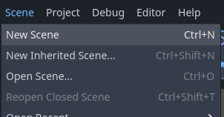
New Scene
So far in our Godot journey, we have primarily looked at 2D scenes and 2D nodes, however, Godot is a very versatile engine that also allows you to create 3D games. To begin with, we need to create a new 3D scene. To do this, choose New Scene from the Scene dropdown in the top left of the screen.

Slide 4
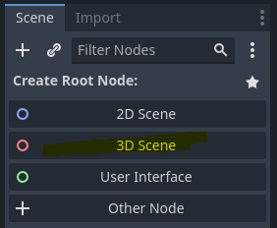
Select Mode
This will create a brand new scene, which we will select 3D Scene as the route.

Slide 5
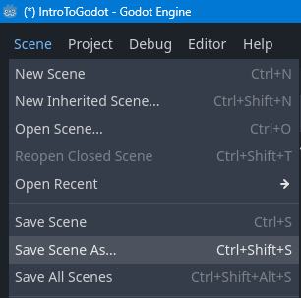
Select Mode
This will automatically switch the viewport to the 3D mode and create a root node of Node3D. To keep this scene, choose the Scene menu again, and press Save Scene As.

Slide 6
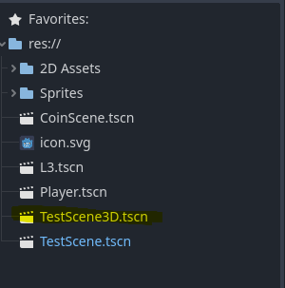
Select Mode
This will automatically switch the viewport to the 3D mode and create a root node of Node3D. To keep this scene, choose the Scene menu again, and press Save Scene As.
We will be calling ours TestScene3D.tscn.

Slide 7
Navigating the 3D Environment
To navigate the 3D environment, use the following controls:
Hold the right-mouse button to look around the scene
Use the W A S D keys to fly around the scene
Use E to go upward
Use Q to go downward
Use the middle mouse to orbit around the center of what is on the screen.

Slide 8
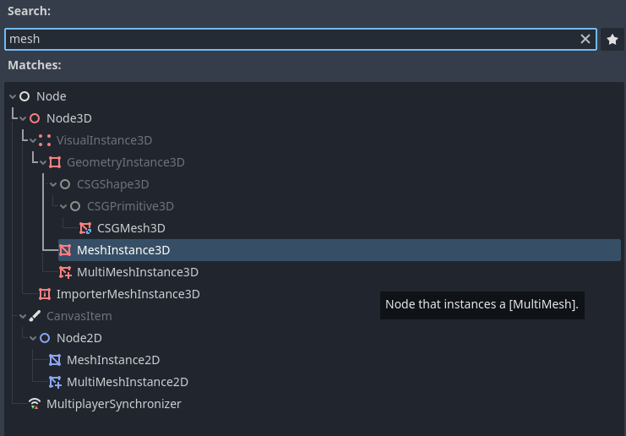
Creating 3D Objects
In 2D Godot, we use Sprites as a way to show us stuff, however, in 3D we use a Mesh Instance node. To create a Mesh Instance, you can either drag in a 3D model that you have, or you can create
a basic primitive mesh like we will be using. To start this, create a new MeshInstance3D node in the scene.

Slide 9
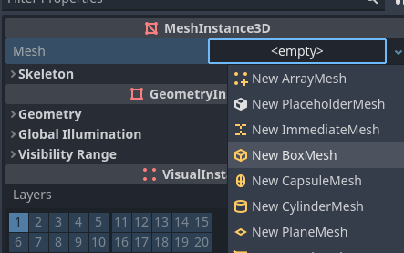
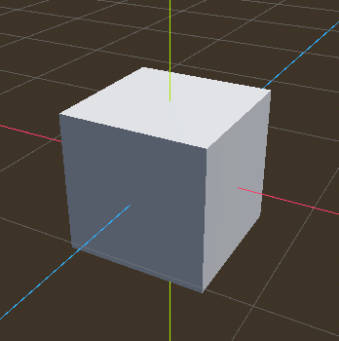
Creating 3D Objects
To add a primitive mesh to this, click on the Mesh property dropdown and select New BoxMesh.
This will create a cube. You can then use the move, rotate, and scale tools to manipulate the cube in the viewport.

Slide 10
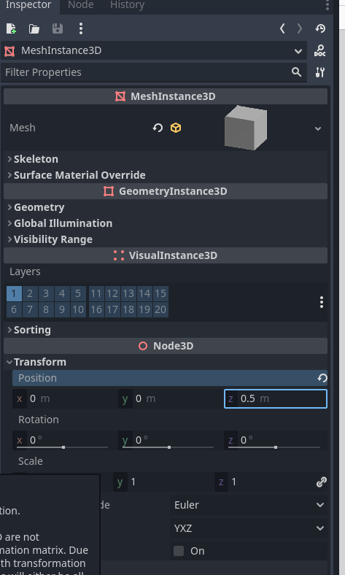
Creating 3D Objects
When using the move tool, you will notice there is an extra axis, the Z axis. This is for the depth of an object, which is something that doesn’t exist in 2D. This value can also be edited from a node’s transform property.

Slide 11
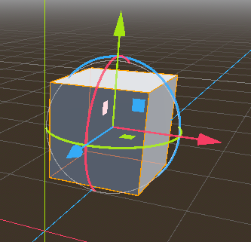
Creating 3D Objects
In addition to using the arrows to move. You will also notice that in 3D, you have three boxes to fill in for the position property. These can be used to move along multiple axes at the same time.

Slide 12
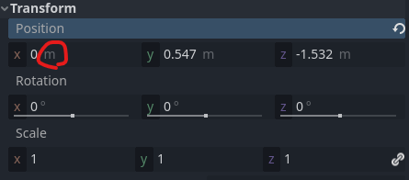
Units of Measurement
Another difference in 3D is the units of measurement. In 2D, distances are measured in pixels, whereas in 3D, distances are measured in meters. You will notice this inside the transform values as well, where the units are labeled.

Slide 13
Units of Measurement
Another difference in 3D is the units of measurement. In 2D, distances are measured in pixels, whereas in 3D, distances are measured in meters. You will notice this inside the transform values as well, where the units are labeled.

Slide 14
Materials
Materials are an important part of 3D rendering, as they tell the computer how to render an object to the screen. In fact, to display our snowman in grey, the MeshInstance nodes already have a default material assigned to them, this allows the meshes to be drawn on the screen, cast shadows, and interact with the lighting of the game.

Slide 15
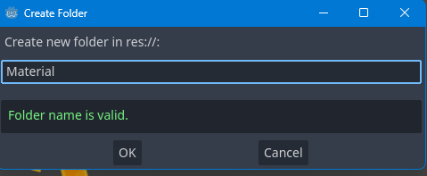
Creating a Material
In Godot, materials are stored as resources and can be modified to change the look of an object.
Before creating a material, we first want to create a folder in the file system called Materials.

Slide 16
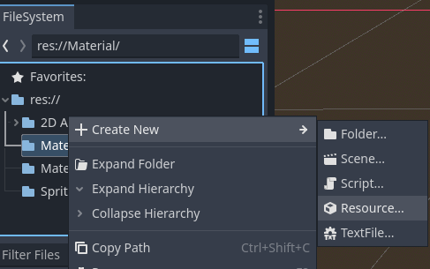
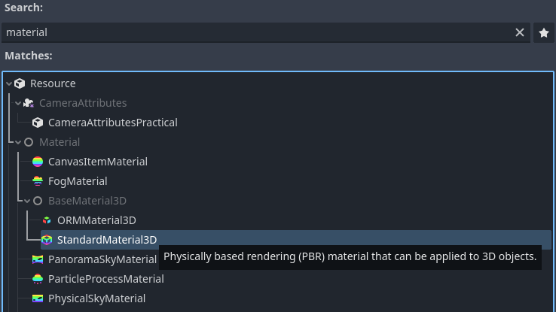
Creating a Material
Then right-click and select New and then Resource, and search for material. We can then select StandardMaterial3D and give it a name, we will call ours TestMaterial.tres.

Slide 17
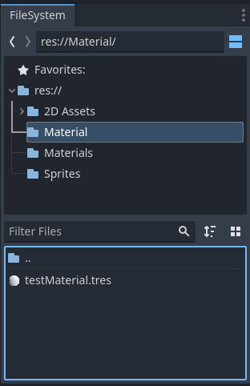
Creating a Material
This will create our TestMaterial.tres file in the materials folder.

Slide 18
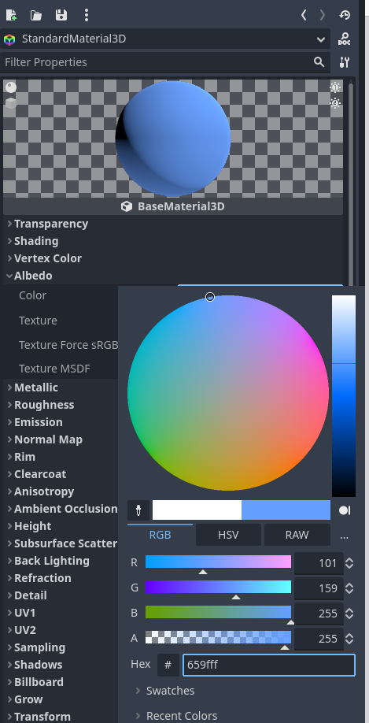
Modifying a Material
Once the material is created, it can be modified in the Inspector window.
There are a variety of properties that can be changed, such as the texture, roughness, shininess, color, and transparency.
To change the color of the material, we will open the Albedo dropdown and change the color property to a color you like.

Slide 19
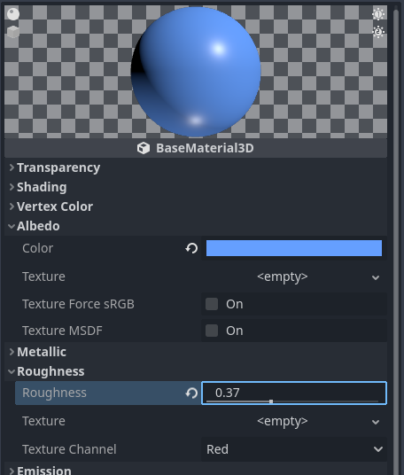
Modifying a Material
You can also change the roughness and metallic values to give the material a more reflective or matte look, you will see this change represented in the sphere preview at the top.

Slide 20
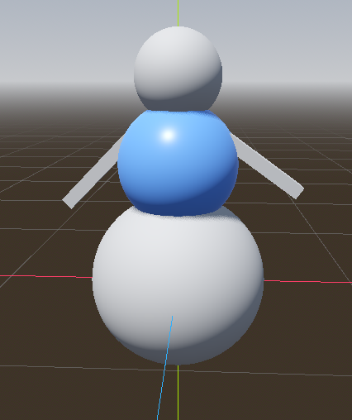
Applying a Material
To apply the material to a mesh, simply click and drag the material onto the mesh.

Slide 21
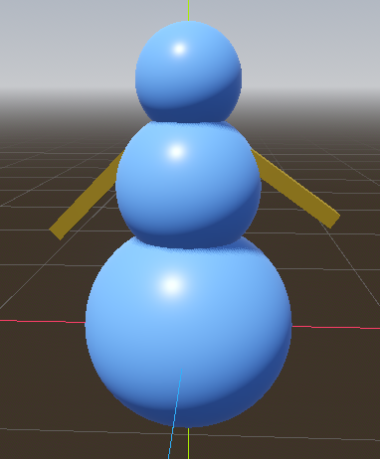
Applying a Material
You can then drag this material onto any MeshInstance3D node to change its material to the new one.

Slide 22
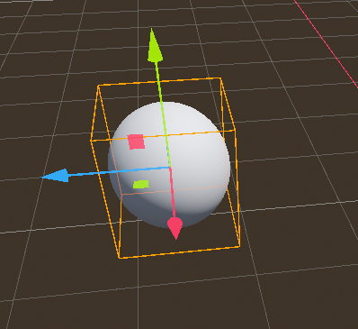
Lights
Lighting is an important part of creating a 3D game, it sets the mood and theme of the game and can be used to create interesting effects. In this article, we will look at the different types of lighting nodes available in Godot Engine, and how to use them.
To begin with, we need a MeshInstance3D node to show the effects of the light, which for our case we will add a Mesh property of SphereMesh.

Slide 23
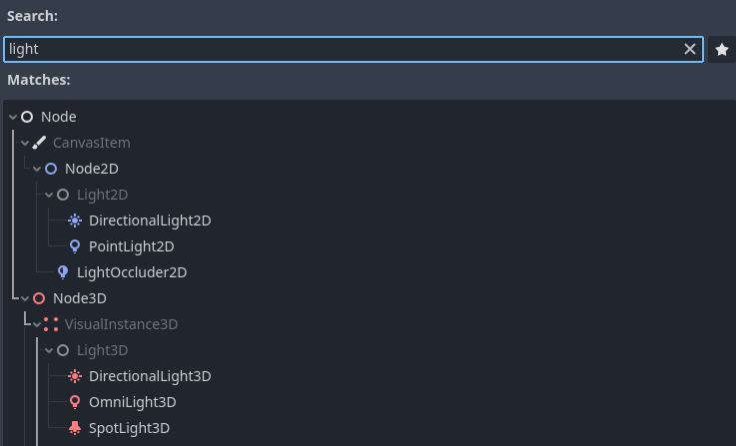
Lights
If you search for light in the Create New Node menu, you will see that there are three types of light available in Godot. We will cover each of them below.

Slide 24
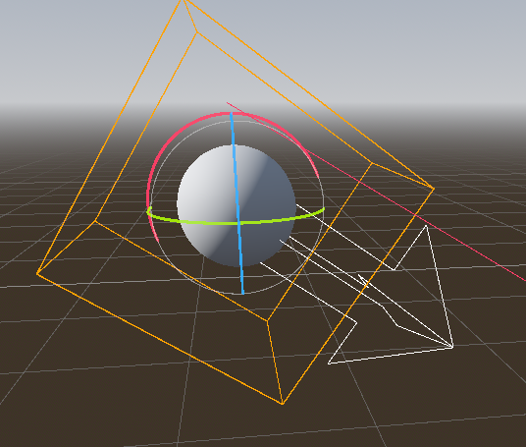
Directional Light
A Directional Light is like the sun, emitting light in a single direction. When you create it, you will see a white arrow pointing in the direction that the light is coming from.
You can rotate the Directional Light node to change the direction of this arrow, and therefore the direction that the light faces in.
A directional light has an infinite range and will cover your entire scene, but only from the angle it is facing, the position of the Directional Light will also not change how it affects the scene.

Slide 25
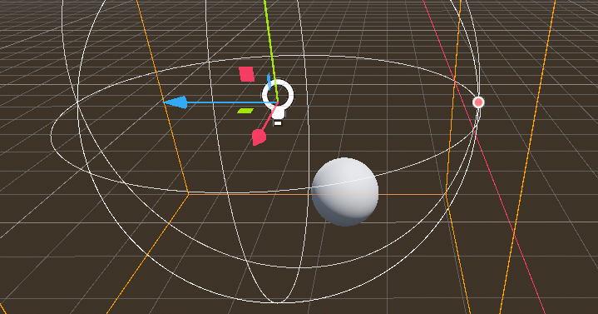
Omni Light
An Omni Light emits from a single point in all directions, like a candle or light bulb, it acts much like a light in real life. When you create an OmniLight3D node, you will see a wireframe sphere on the outside, which represents the range of the point light. You will notice if you move the light next to the sphere, it lights it up from the origin point.

Slide 26
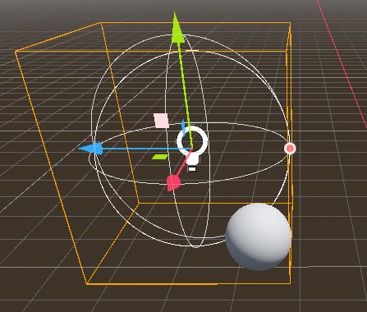
Omni Light
You can change the range of the light, by clicking and dragging on the orange circle that appears on the edge of the wireframe.

Slide 27
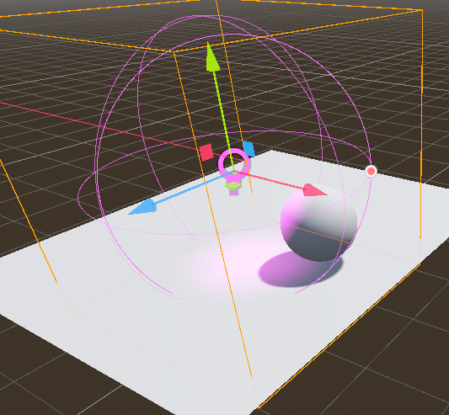
Omni Light
Just like with the Directional Light, you can also change the color and energy of the light in the inspector. To make it easier to see the effect of the light, you can create a PlaneMesh, using a new MeshInstance3D.

Slide 28
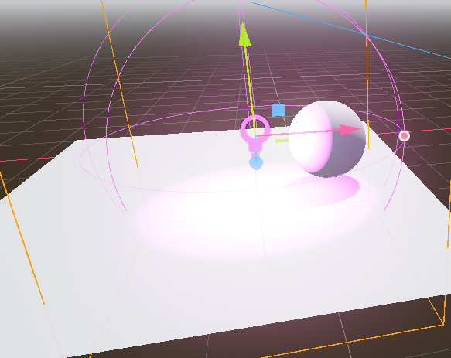
Omni Light
You can also bring the Energy of the Directional Light down to 0 to disable the light temporarily, to make it easier to see the effects of the OmniLight3D. You can then change the Color and the Energy properties to create a cool light effect.

Slide 29
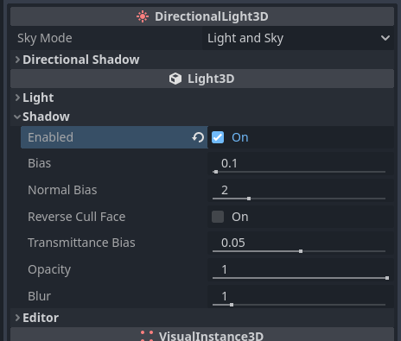
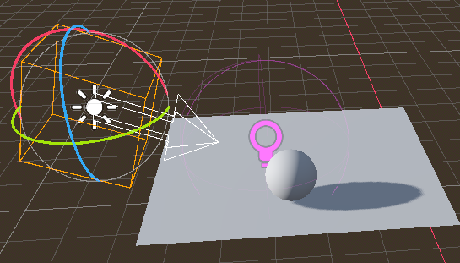
Omni Light
With lights we also want shadows, this is a perfect thing to add to our Directional Light as they are often used to simulate a sun. To make it easier to see the shadows, set the Energy of the OmniLight3D to 0. Then, in the Directional Light, open the Shadow dropdown and tick Enabled.
This will enable shadows in our scene from the Directional Light.
The same can be done for any other type of light.

Slide 30
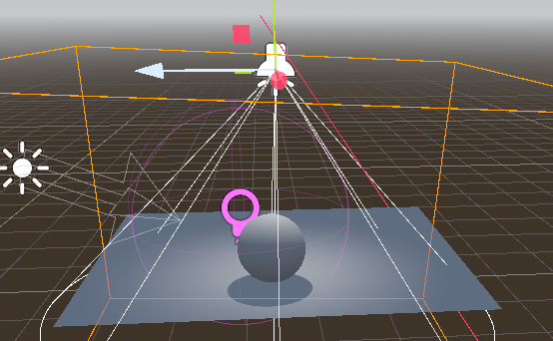
Spotlight
A SpotLight3D node emits in a cone shape and is good for things like headlights and street lamps.
Once you create a Spotlight, you will see a white cone wire frame, which shows the angle of the light. You can click and drag on the orange circles to change the angle and range of the light.

Slide 31
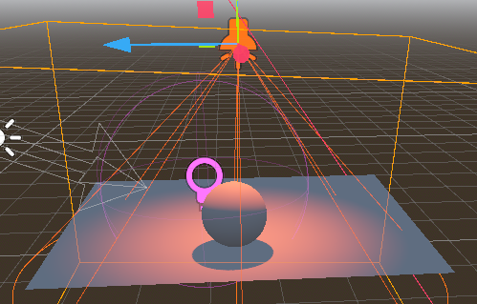
Spotlight
You can also change the color and energy of the light in the inspector, just as you can with any light.
To cast a shadow, open the shadow dropdown and enable it.

